Slide 1
Develop a Proposal

Slide 2
Proposals
What could I make?
I could make a Hangman game in Python, a snake game, a quiz program, or calculator program.
Why did I choose this?
I am going to make a Hangman game because it will allow me use various skills and I have plenty of ideas to make it more unique then a standard hangman game.
Why not chose this?
I don’t think I could add anything complex to a snake game or a quiz program, a calculator program seems like something too simple but also interesting to create, however I think I could do something more with a Hangman game.

Slide 3
Proposals Cont.
What does it do?
My Hangman game will allow the user to select a random word from a text file, the user can also add their own lists to chose from, the user can also enter a word to use if they would like to play with their friends. The game will save the user’s time taken, guesses used, win/loss and the word they were guessing, the user will be able to export their session results to a text file
What could it do?
I could make it refuse to accept wordlists with offensive names, this however would be hard to implement and would require a large list of offensive terms to check file names against.
I could allow the user to delete word lists if they would like, this would fulfil the above problem because if a user was offended by a name, they could remove it.
I could make the game statistics sortable by each statistic.
Why should it do that?
The program would further fulfil social and cultural implications by doing so, it would make sure that anyone can use the program by using gender neutral and non-offensive language everywhere.
Making the game statistics sortable by each statistic would allow users to quickly find out specific information, this would also fulfil the accessibility implication.

Slide 4
Addressing Relevant Implications
Social Implications
My program will use gender neutral language whenever possible and avoid using offensive symbols as to not cause harm to any users.
I will keep the language formal and easy to understand as to make sure everyone can use my program.
Cultural Implications
My program will not use any offensive material to any culture and will be useable by all people, in order to cause less offense my program will allow users to delete word lists, users can delete any word lists that they feel has offended them or has offensive content. This is because I cannot possibly make my program filter every single offensive term and check each list and list name for offensive terms.
I will make sure that my program is inclusive by not using any text or images that could offend any groups.

Slide 5
Addressing Relevant Implications
Legal
In order to comply with copyright law I will only use images or text licensed for re-use or images I have created.
In order to comply with privacy law I will not use images or depictions of people without their express permission to do so.
Intellectual Property
I will not copy any property without express permission, any intellectual property I use will be licensed for re-use under creative commons.
Information used will be from my own knowledge or from the public domain.
Any information or intellectual property used will be credited to the relevant publisher/owner.

Slide 6
Addressing Relevant Implications
Ethical
My program will not collect user data, in order to fulfil the ethical considerations my program will not insult, offend or spy on users.
For example my program will not use the user’s CPU or GPU to mine for crypto currency.
Privacy
I will not collect data; therefore I will not have to store any user information. The only data stored by the program is non-personal and is saved to the same folder as the program.

Slide 7
Addressing Relevant Implications
Health and Safety
My program will have no online component, this is to prevent harassment and cyber-bullying.
My program will have a timer displayed to show how long the program has been running for, when the timer reaches 15 minutes, a message will pop up suggesting to the user that they should take a break to prevent eye strain.
Aesthetics
  My program will be pleasant to look at, I will use complimentary colours that are not harsh on the eyes, especially in the dark.
  My program will use an easy to read font that does not look too bad, this will improve readability for the user.

Slide 8
End User Considerations
My program will be attractive to look at, have an easy to use GUI with simple instructions, as well as more in-depth ones if the user wishes to look at them.
My program will take into account the users health and safety to make sure that no harm is done by the program.
It will be inclusive and accessible to everyone; this includes using gender-neutral language and non-offensive symbols to make sure nobody is offended by my program.
My program will be private, no user data will be stored, and game data will only be saved if the user wishes it to be saved, that can then be deleted afterwards by the user.
My program will not use any copyright protected material and will only use material of my own making or material licensed for re-use.

Slide 9
Brief / Introduction
For my program I will be creating a Hangman game in Python with a GUI. I will be using the python library Tkinter for this, I will also be using GitHub and the Git application to keep previous versions. I will be making use of classes and modules to create a program, I will follow naming conventions for variables to create public and private variables as they are necessary for this standard even though Python does not support them.
The program will ask users if they want to select a random word from a list stored in a text file, or a word the user has entered. The user will be able to view their previous results and see how long they took and how many guesses they needed to win, the user will be able to export their results to a text file, the user will also be able to import word lists from a text file. The user will be able to guess either letters or a word using an onscreen keyboard made in the program, or by typing into an entry box.

Slide 10
Specifications and Constraints
The player will get 10 guesses per phrase.
Only phrases consisting of alphabetical characters that are under an undecided character limit.
The time taken and guesses remaining/used, will be stored after a game has finished.
The average and best statistics will be displayed, all statistics will be displayed on the game history window.
Statistics will be able to be exported to a text file.
Wordlists will be importable from a text file.
If the player quits the game will not save.
The game window cannot be resized or full screen, it can be minimized and moved around

Slide 11
Resources used.
Python 3.8
Wing IDE Pro 7.2
GitHub and Git GUI 2.26.2
Lucid Charts Diagrams
NumPy library
time library
random library
Tkinter library

Slide 12
Timeline (Gannt Chart)
Located in folder.

Slide 13
Version Control
I will be using the Git desktop client to keep older versions; I will then upload this to GitHub at the end of the project for easy access.

Slide 14
Classes
none are private.
Name | Functions:
MainWindow | __init__, game_window, history_window, wordlist_window, game_information, get_wordlist
GameWindow | __init__, main_window, get_phrase, get_letters
HistoryWindow | __init__, export_scores, get_victory, get_winloss, get_guesses
WordlistWindow | __init__, import_wordlist

Slide 15
Functions and Variables
Name | Class | Type | Purpose | Variables
export_scores | HistoryWindow | Definition | Take all the statistics for the session and export them into a file. | line – all the stats for a game will be on one line.
import_wordlist | WordlistWindow | Definition | Imports a list of phrases to be used when randomly selecting a phrase for the game. | wordlist – the current wordlist for the game.
main_window | GameWindow | Definition | Re-opens the main window and closes the game window when the game ends. | game_frame – will be destroyed when this function is called
game_window | MainWindow | Definition | Closes the main window and opens the game window when a game is started. | main_frame – will be destroyed when this function is called.
history_window | MainWindow | Definition | Opens the history window for all the game statistics. | winLoss – used to send the win/loss ratio to the history window victory – used to send the victory bool to the history window phrase – used to send the phrase to the history window guesses ­– used to send the number of guesses taken to the history window
wordlist_window | MainWindow | Definition | Calls the WordlistWindow class to open the wordlist window | None

Slide 16
game_information | MainWindow | Definition | Selects a word or uses the one entered by the player, creates lists for the letters. | wordlist – list containing phrases to be used in the game phrase – defined in this function as a random item in the wordlist, or as the entry from the user. letters – list of character in the phrase variable
init__ | MainWindow | Definition (Initialized) | Creates all the GUI elements for the main window and sets variables. | main_frame – the from that holds each GUI element heading_label – hangman heading text instruction_label – user instructions text wordlist_button – button to call the wordlist_window function history_button- button used to call the history_window function random_button – calls the game_information function with a bool of ‘false’ chosen_button – calls the game_information function with a bool of ‘true’ quit_button – calls the quit function to close the GUI and stop the program
init__ | GameWindow | Definition (Initialized) | Creates all the GUI elements for the game window and sets variables. | game_frame – the frame which holds all the GUI elements for the window (a-z)button – buttons for each letter of the alphabet which phrase­_label – label that displays the phrase the user is finding stats_label – label that displays the time taken, guess remaining and used. letters_label – label that displays the letters the player has guessed.
init__ | WordlistWindow | Definition (Initialized) | Creates all the GUI elements for the wordlist window and sets variables. | wordlist_frame – the frame that holds all the GUI elements for the wordlist window. import_button – button which opens file explorer to select the file to be used. instructions_label – label for the instructions text. dismiss_button – button to close the wordlist window and re-enable the. wordlist – list of all the possible phrases the game can use.
init__ | HistoryWindow | Definition (Initialized) | Creates all the GUI elements for the history window and sets variables. | history_frame-the frame that hold all of the GUI elements for the history window statistics_frame – frame inside the history frame to hold the GUI elements for each game’s statistics statistics_label – label for each games statistics, will be updated for each game. game_set- Queue of each game’s statistics played this session, used to order the games on the statistics_label dismiss_button – button to close the window and re-enable the main window export_button – button to export all the results into a text file.

Slide 17
get_wordlist | MainWindow | Definition | Returns the current wordlist when called. | wordlist - variable that is returned when the function is called.
get_phrase | GameWindow | Definition | Returns the current phrase when called. | phrase – variable that is returned when the function is called.
get_letters | GameWindow | Definition | Returns the current list of letters when called | letters – variable that is returned when the function is called.
get_guesses | HistoryWindow | Definition | Returns the number of guesses when called. | guesses – variable that is returned when the function is called.
get_victory | HistoryWindow | Definition | Returns a bool if the game was won or not. | victory – a bool of either True or False that is returned when the function is called.
get_winloss | HistoryWindow | Definition | Returns the number of wins and losses for this session. | winloss – variable of the winloss ratio that is returned when the function is called.

Slide 18
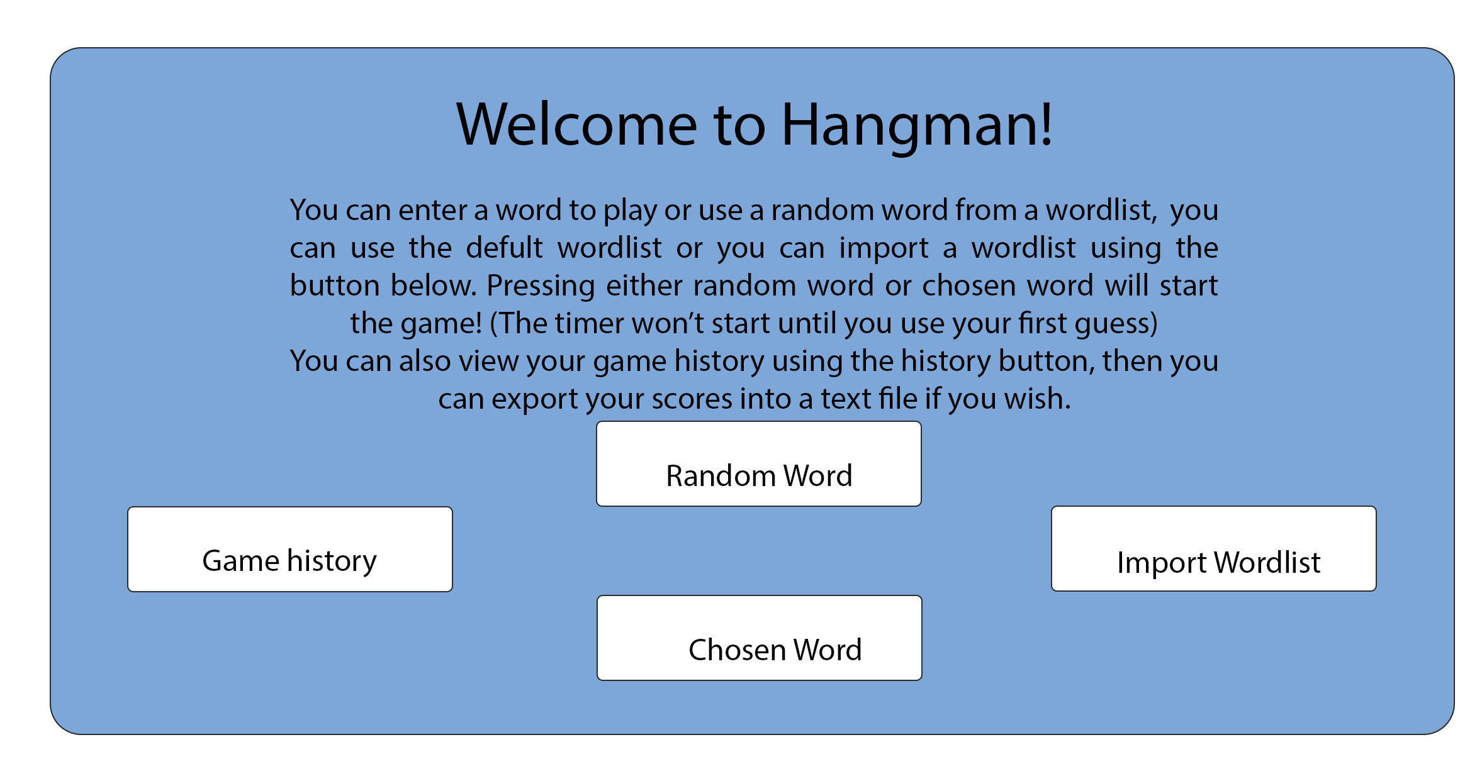
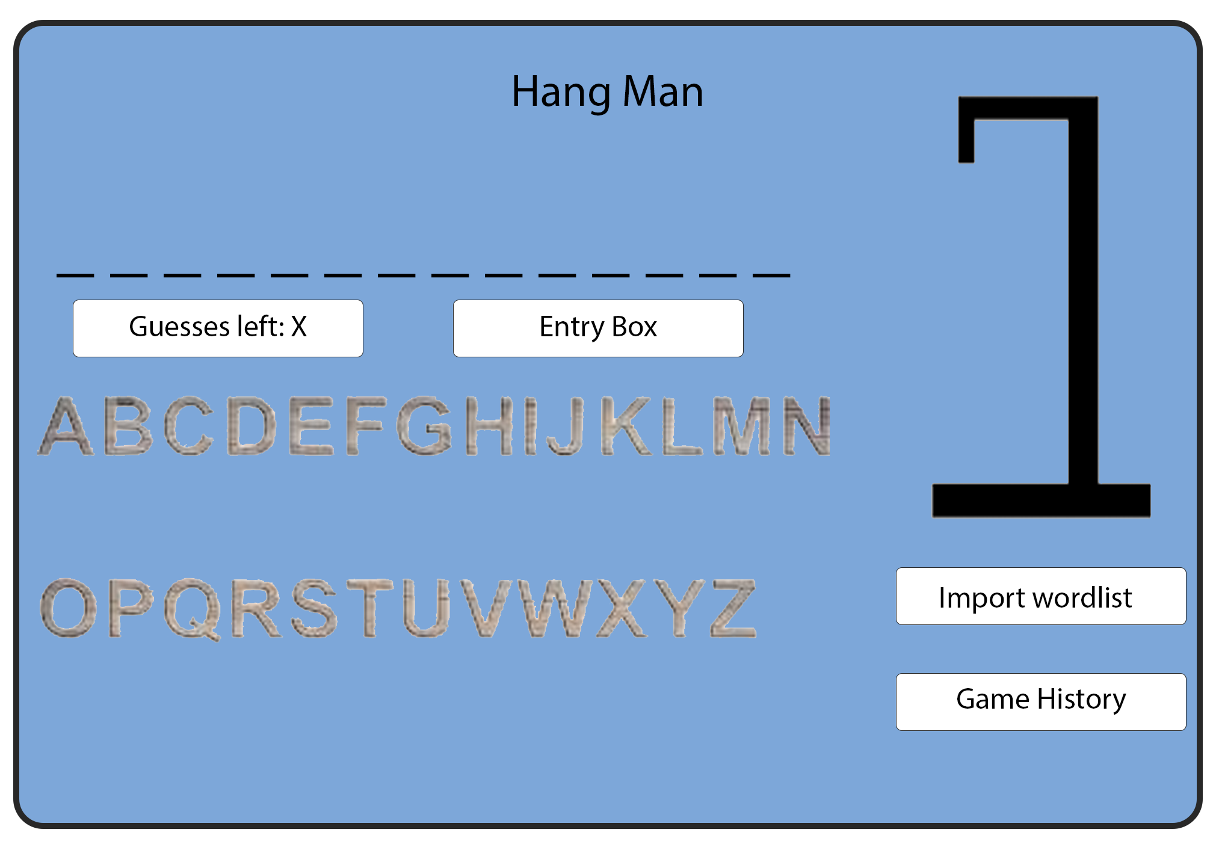
Graphical User Interface Design (GUI)
Both ‘Random’ and ‘Chosen’ Word buttons will start the game and open a new window. The only difference is the settings for the game will change.
The import wordlist button will simply open file explorer so that the user can choose a text file for the program to use.

Slide 19
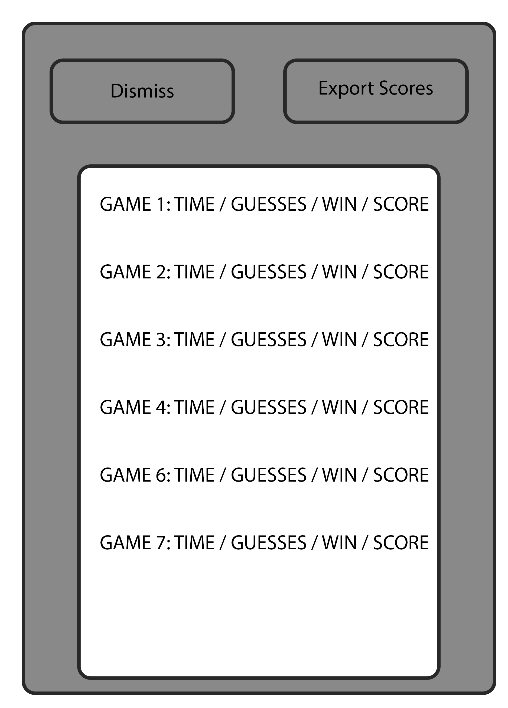
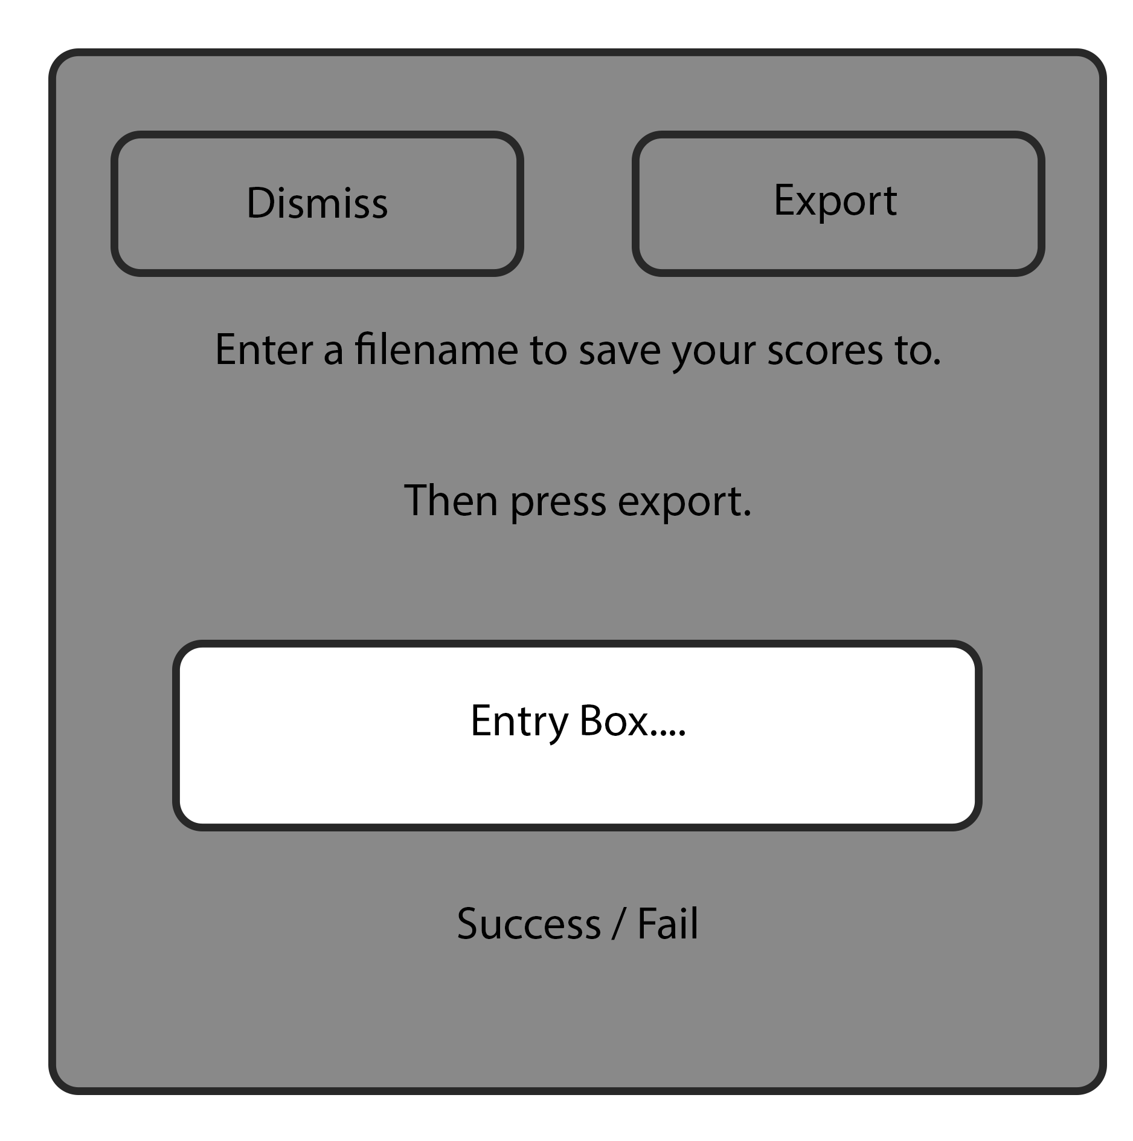
GUI (Continued)
This is the game history window which opens when the ‘Game History’ Button is pressed.
←
This is the window to save all your scores to a file.
→

Slide 20
Research
If you were to play a Hangman game would you rather have Clickable buttons or Radio Buttons?
Would you rather have

Slide 21
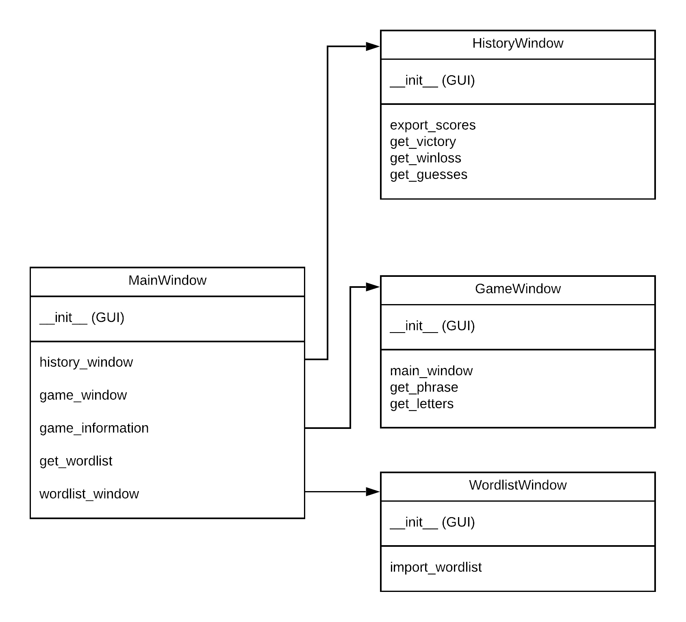
Program Structure

Slide 22
Program Decomposition
Components needed currently. (Definitions)
export_scores
import_wordlist
main_window
game_window
history_window
game_information
wordlist_window
__init__
get_wordlist
get_phrase
get_letters
get_guesses
get_victory
get_winloss

Slide 23
Component Development

Slide 24
Component 1
Main menu
The goal is to create the main GUI of the Hangman game as planned, to allow the user to press each button. To show this I will add temporary windows for each button press, I will make sure the user can’t keep pressing the button to create duplicate windows. I will also make sure that when the temp window is closed the buttons will re-enable themselves.

Slide 25
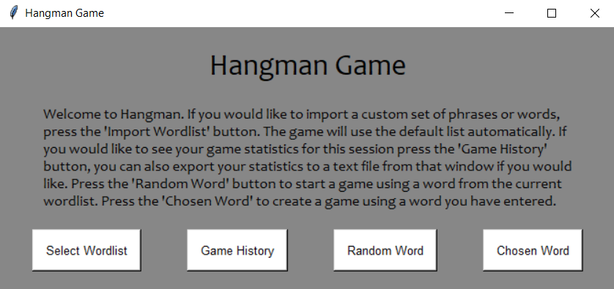
Main Menu Trialing – Clickable Buttons
Pros
Looks the best
Easiest to use
Easiest to code
Cons
Colour choice could be better
Too much information

Slide 26
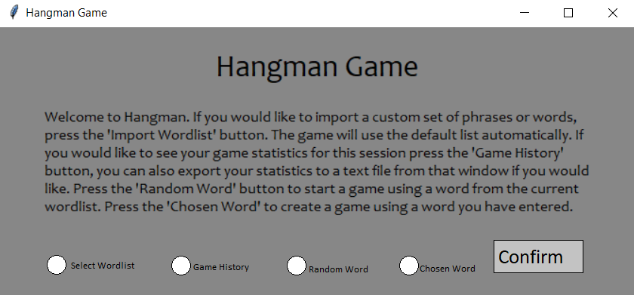
Main Menu Trialing – Radio Buttons
Pros
User can confirm their choice
Cons
Harder to use
Harder to implement
Uglier

Slide 27
Component 1
Main menu testing
Test Case | Intended Effect | Actual Effect
Select Wordlist Button is pressed. | Window to select the Wordlist for the game opens. | Window to select the Wordlist for the game opens.
Random Word button is pressed with no wordlist selected | Wordlist window opens and the game prompts you to select a wordlist | Wordlist window opens and the game prompts you to select a wordlist
Random Word button is pressed with a wordlist selected | Game starts with a random word | Game starts with a random word
Chosen Word is pressed | Window for user to enter a word opens | Window for user to enter a word opens
Game History is pressed with no games played | Menu warns you that no games have been played and prompts you to play a game | Menu warns you that no games have been played and prompts you to play a game
Game History is pressed with games played | History window opens up | History window opens up

Slide 28
Component 2 Wordlist Window
This window will control which words the game uses for Hangman, it will create buttons for each text file in the same folder as the program, this way the user can add their own lists apart from the 2 included.
The way this will work is it will scan the first lane of the text file to use as the name of the wordlist, if the first line of 2 files are the same the game will read them with the same name.
Test Case | Intended Effect | Actual Effect
No Wordlist has been selected so far and the user selects the ‘Countries’ list. | The menu displays the selected wordlist as ‘Countries’ | The menu displays the selected wordlist as ‘Countries’
The user has added a custom list to the program folder with the first line of the list being ‘Brand Names’ | A ‘Brand Names’ Button is created by the program next time the window is opened. | A ‘Brand Names’ Button is created by the program next time the window is opened.

Slide 29
Component 3 Game Window
This window will be where the game is played, it will have an image that updates each time the player guesses wrong. There will be a button for each letter of the alphabet and you will press those buttons to guess, once a button is pressed then the button will be disabled and the letter will be added to the guessed letters area, if the letter was in the word than it will be reflected on the display. A timer will be measuring how long the player takes to either win or lose.

Slide 30
Game Window Testing
Test Case | Intended Effect | Actual Effect
Buttons corresponding to each letter are pressed. | The letter from the button either updates the word if it was in the word or it goes to the guessed letters area. The button disables itself. | The letter from the button either updates the word if it was in the word or it goes to the guessed letters area. The button disables itself.
The word is correctly guessed | The display says that the player has won and the timer pauses | The display says that the player has won and the timer pauses
The player runs out of guesses | The display says the player has lost and the timer pauses | The display says the player has lost and the timer pauses
The player incorrectly guesses a letter | The image updates to a further stage of hangman and the button is greyed out. | The image updates to a further stage of hangman and the button is greyed out.
The player correctly guesses a letter | The display updates and the button is disabled | The display updates and the button is disabled

Slide 31
Component 4 Game History
At the end of the game the program will record various statistics for the game and store them in a list, the game history window will display the statistics of each game in that session and provide buttons to sort through the stats with. It will also provide an export button if the player wishes to export their stats to a csv file.

Slide 32
Game History Testing
Test Case | Intended Effect | Actual Effect
The use can sort through the statistics by pressing each of the sorting buttons | The list is sorted by the corresponding button that the user pressed | The list is sorted by the corresponding button that the user pressed
The user tries to open the game history window with no games played | The window does not open and instead the main menu prompts the player to play a game before trying to access statistics | The window does not open and instead the main menu prompts the player to play a game before trying to access statistics
The export stats button is pressed | The program exports all the stats from the session into a csv file with the correct format. | The program exports all the stats from the session into a csv file with the correct format.

Slide 33
User Guide
General
To open the program open ‘Code.py’ in an IDE and run the code.
Follow the instructions provided on the GUI
Despite the use of ‘wordlists’ the game will run fine with phrases containing spaces up to a character limit of 30, such as; ‘Hello There’
Adding Words / Phrases
To add a custom list of words/phrases for the game to use place a text (must be .txt) file of any name in the same folder as ‘Code.py’ have the first line as the name of list, e.g: Famous People. On the following lines the file can have as many entries as you would like, anything on a line will be read by the program as a phrase and can be randomly selected for the game. Two files of the same name with different first lines will be read as two different files.
Exporting Stats
Exporting your game statistics will only export the statistics of the session as ‘Gamestats.csv’ to the same folder as ‘Code.py’. It will overwrite the previous file, or any file named ‘Gamestats.csv’.
Testing
For testing purposes a custom word can be entered using the ‘Custom Word’ button on the main menu, there is a character limit of 30 and only alphabetic characters and spaces can be used.

